Slide 1
Cooper basin
History of the project and lesson

Slide 2
1
History of the project

Slide 3
2
Initial conditions
Potential difficulties
Favorable factors
Australian continent is under regional overthrust tectonic stress
Australian continent is under regional overthrust tectonic stress
sgkFOB
LH

Slide 4
Write here
Something about
WRITE SOMETHING HERE
Entrepreneurial activities differ substantially depending on the type of organization and creativity. Entrepreneurial activities differ substantially depending on the type of organization and creativity. Entrepreneurial activities differ substantially.

Slide 5
Write here
Something about
WRITE SOMETHING HERE
Entrepreneurial activities differ substantially depending on the type of organization and creativity. Entrepreneurial activities differ substantially depending on the type of organization and creativity. Entrepreneurial activities differ substantially.. Entrepreneurial activities differ substantially depending on the type of organization and creativity.
Entrepreneurial activities differ substantially depending on the type of organization and creativity. Entrepreneurial activities differ substantially depending on the type of organization and creativity. Entrepreneurial activities differ substantially.. Entrepreneurial activities differ substantially depending on the type of organization and creativity.

Slide 6
Write here
Something about
WRITE SOMETHING HERE
Entrepreneurial activities differ substantially depending on the type of organization and creativity. Entrepreneurial activities differ substantially depending on the type of organization and creativity. Entrepreneurial activities differ substantially.. Entrepreneurial activities differ substantially depending on the type of organization and creativity.
Entrepreneurial activities differ substantially depending on the type of organization and creativity. Entrepreneurial activities differ substantially depending on the type of organization and creativity. Entrepreneurial activities differ substantially.. Entrepreneurial activities differ substantially depending on the type of organization and creativity.

Slide 7
OUR LATEST
WORKS
WRITE SOMETHING HERE
PROJECT NAME
PROJECT TITLE
WRITE HERE
Entrepreneurial activities differ substantially depending on the type of
Entrepreneurial activities differ substantially depending on the type of
Entrepreneurial activities differ substantially depending on the type of

Slide 8
WRITE SOMETHING HERE
UNITED
KINGDOM
MAP
Entrepreneurial activities differ substantially depending on the type of organization and creativity. Entrepreneurial activities differ substantially depending on the type of organization and creativity. Entrepreneurial activities differ substantially.. Entrepreneurial activities differ substantially depending on the type of organization and creativity.

Slide 9
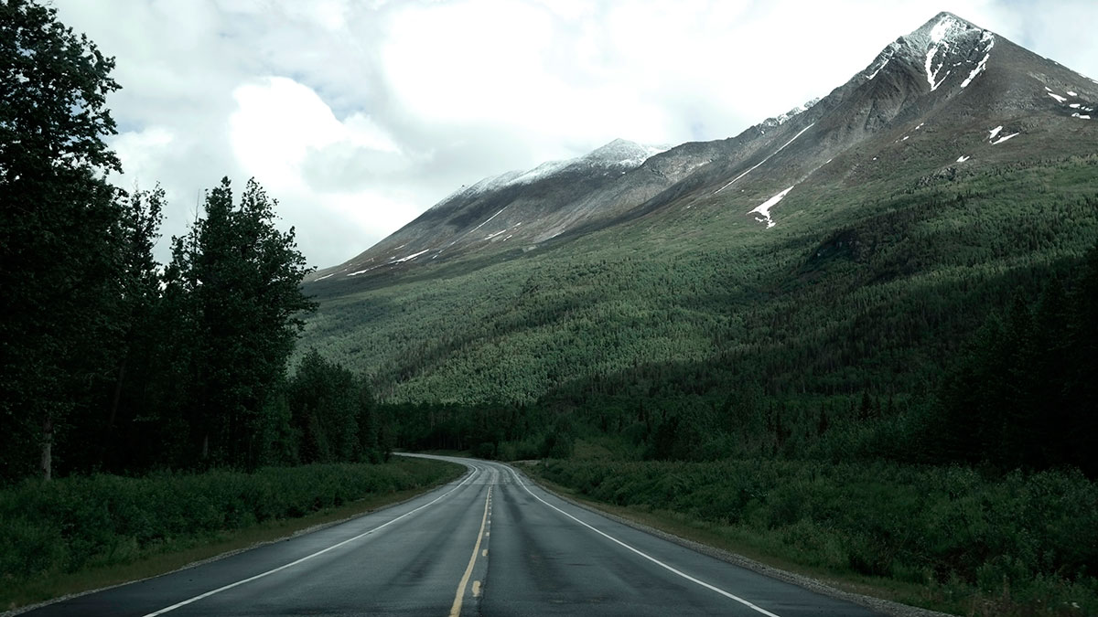
Write here
Something About
WRITE SOMETHING HERE

Slide 10


DOWNLOAD ALL OUR PRESENTATIONS HERE

